Slide 1
Introduction to Android
Get to know Android project basics, its structure, key components, UI and more

Slide 2


Contents
AndroidStudio
Project Structure
Gradle build script
Android key components
Building UI (Compose/XML)
Dependencies, libraries
AndroidX, Jetpack

Slide 3
Android Studio

Slide 4
Android Studio
Essentially the only IDE you’ll ever need for Android
Built by Jetbrains and Google
Impossible number of tools, features and random things you don’t even know about
Lots of quality of life things, like adding images, vectors, generating code
IntelliSense

Slide 5
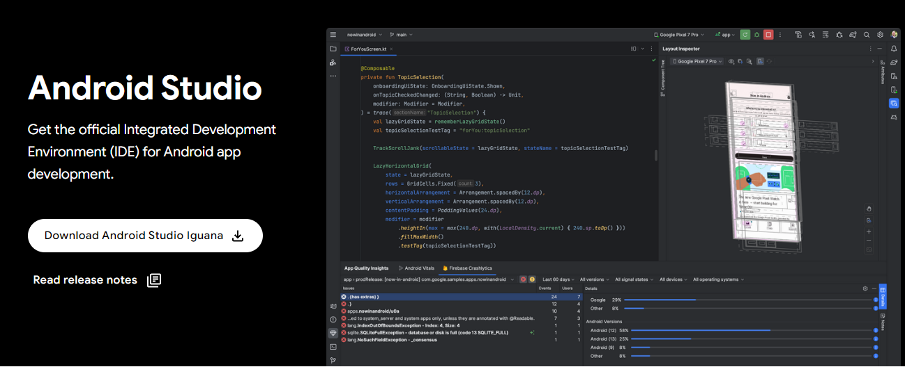
https://developer.android.com/studio

Slide 6
Project Structure

Slide 7
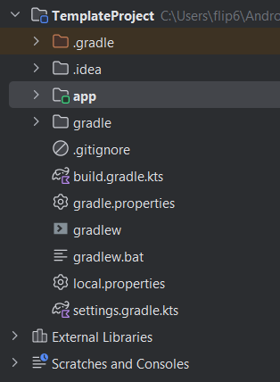

Slide 8
Android Code

Slide 9
Project plugins

Slide 10
Project settings

Slide 11
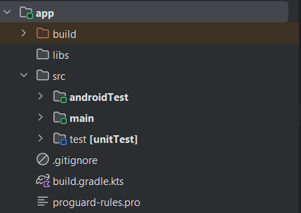
App code

Slide 12
UI Tests

Slide 13
Application

Slide 14
Unit tests

Slide 15
Module configuration

Slide 16
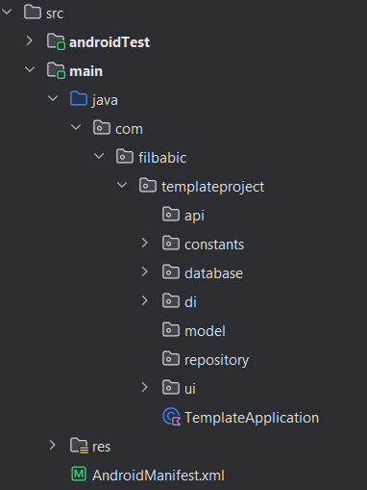
Codebase

Slide 17
Resources

Slide 18
Manifest Definitions

Slide 19
Gradle Build Process

Slide 20
Gradle Build Process
Set of scripts used to run a project
Connects 3rd party dependencies
Loads resources
Packages different files together
Builds an executable file*
Applies signing

Slide 21
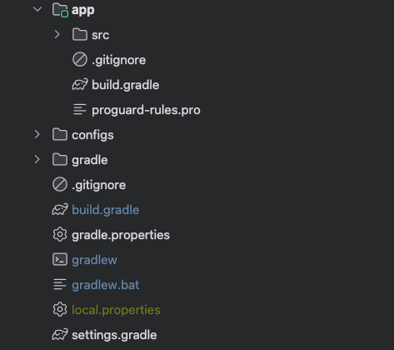
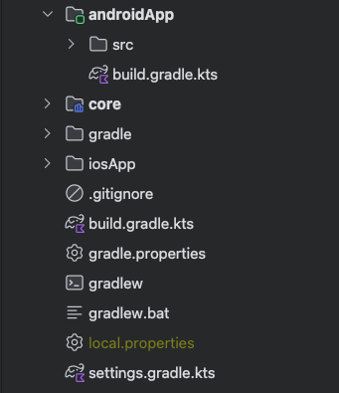

Slide 22
Gradle Script Types
Each type affects different parts of the build
Project-level build.gradle script
Module-level build.gradle script
Settings gradle script

Slide 23
Project-level Script
Applied throughout the project
Ext (external/exported) properties - useful for versions* (moved to .toml)
Repositories used for dependencies
Project level tasks
Project level plugins

Slide 24
Module-level Script
Applied inside a single module
Plugins for that module
Android based configuration & build options
Module dependencies & inclusions (other modules)
Repositories required for the module

Slide 25
Settings Script
Common project configuration*
Plugins! (KTS only)
Dependency resolution (KTS only)
Config like project name, modules to include in build loading…

Slide 26
Android Key Components

Slide 27
Android Key Components
These things pretty much make up an Android app
Activities, Views and Fragments
Intents
Content providers
Services and Broadcast receivers
Android Manifest

Slide 28
Activities, Fragments, Views
Building blocks of the UI and user interaction
Activity - Represents one screen
Fragment - Represents fragmented parts of a UI and logic, usable in multiple screens
View - Base building block of the UI (XML only)
Composable functions - Base building blocks of the UI (Compose)

Slide 29
Intents
Action to open a new screen or trigger a system
Target Activities, Broadcast Receivers or Services
Start a new system
Can contain small pieces of data
Can be restricted to components or application names
Used in notifications*

Slide 30
Content Providers
They provide content!
Used to load data from the Android system database/persistence
Extremely annoying to use
Mostly avoided if possible, but necessary in some cases (like SMS, MMS, contacts…)

Slide 31
Services & Broadcast Receivers
Background systems that trigger events or do work
Services are long or short running background operations
Broadcast receivers receive intents and then trigger behavior or start components (like services)
Receivers can work across-apps
WorkManager* - Essentially a way to replace most services and other background workers

Slide 32
AndroidManifest
Single file describing the core functionality of an app
Defines all Activities, receivers, services, permissions, configuration and so on
Each Android module requires one manifest
Manifests are merged across Android modules*

Slide 33
Building UI (Compose/XML)

Slide 34
Building UI
Two ways - legacy (XML) and modern (Compose)
XML requires of people to learn XML, learn how the View system works, lifecycle, combine XML attributes & programmatic View properties
Compose is fully declarative, no objects, no Views, no XML, only Kotlin and functions
There’s interop -> Can embed XML in Compose and use Compose in XML

Slide 35
Dependencies, common libraries

Slide 36
Common Libraries
Android strongly emphasizes the use of libraries
Database: Room, SQLDelight, Realm
Networking: Retrofit, Ktor
Image Loading: Coil, Glide, Picasso
Parsing: Kotlin Serialization, Moshi, Gson
Various Tooling: Firebase

Slide 37
AndroidX & Jetpack

Slide 38
AndroidX & Jetpack
“Modern” ways of building Android apps
Historically there weren’t strict guidelines for Android app development
Google/Android didn’t suggest any architectural patterns, libraries, code styling
Then Jetpack came and we got a new fresh set of tools for development

Slide 39
